Slide 1
P8自动探针台陶瓷方卡OPEN的原因查找
初步分析
Onezhenji
2022.10.18

Slide 2
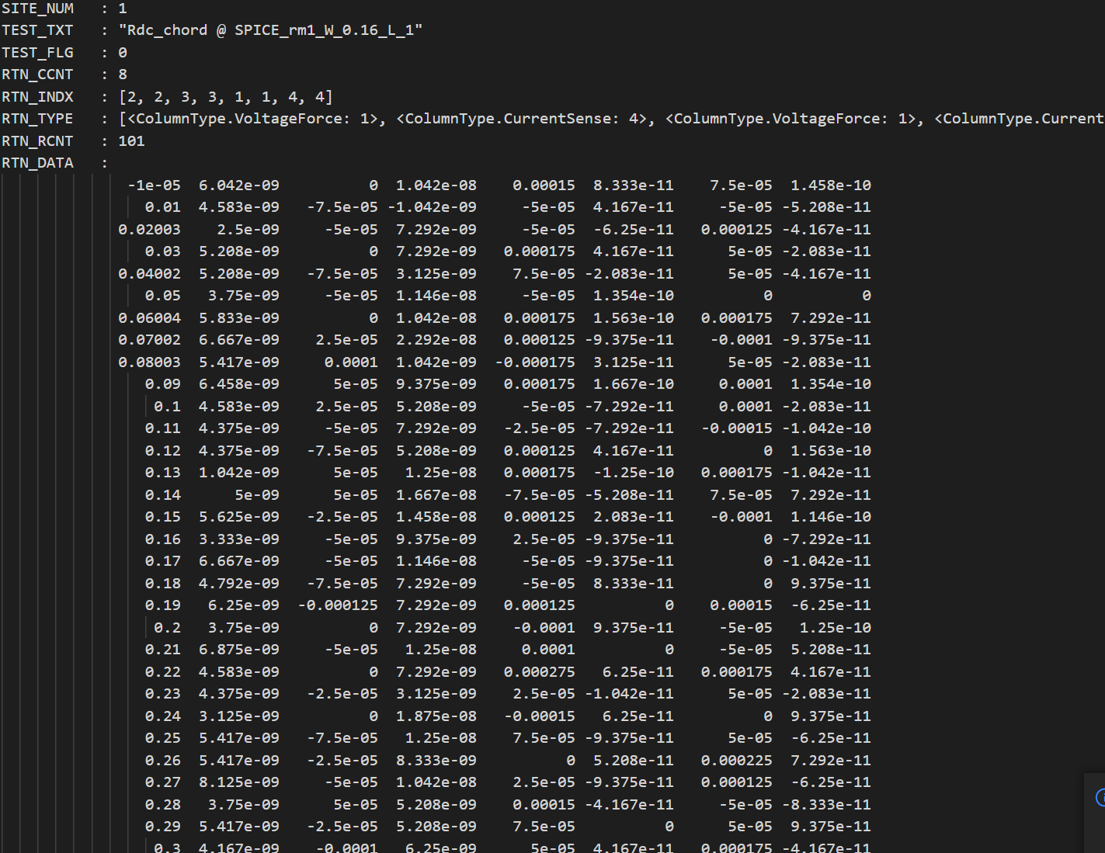
1st Touchdown
Open

Slide 3
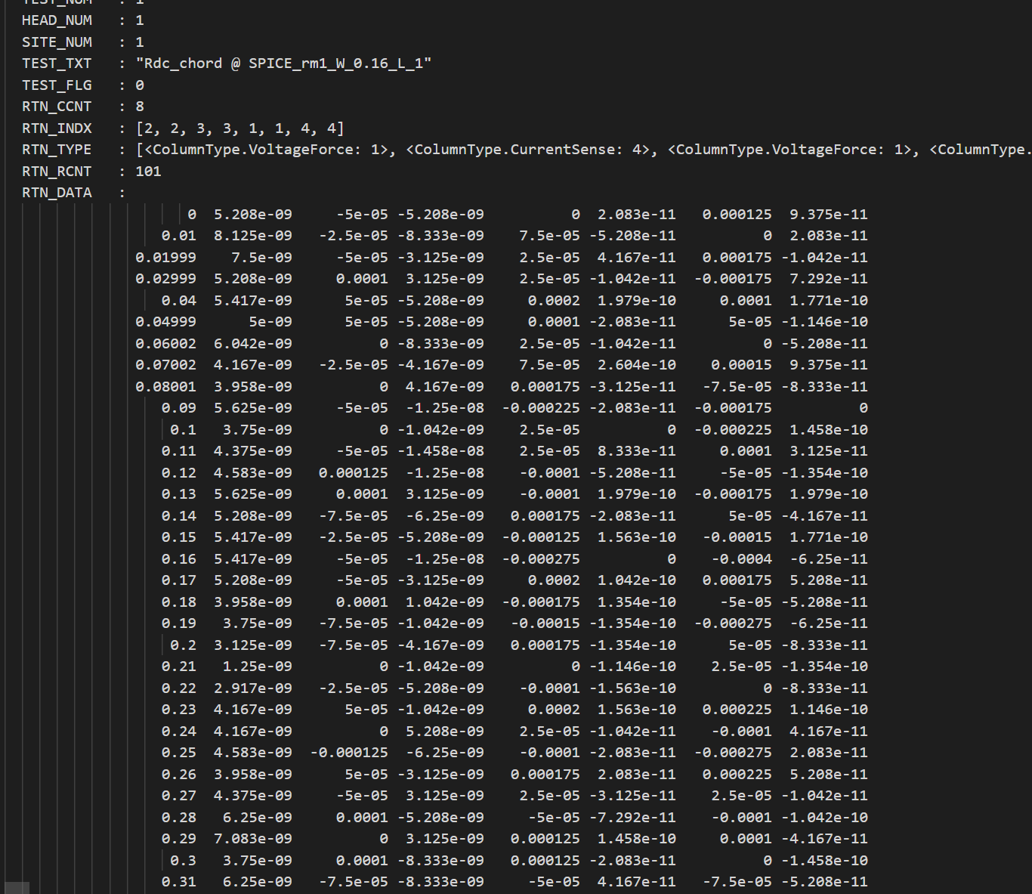
2nd Touchdown
Open

Slide 4
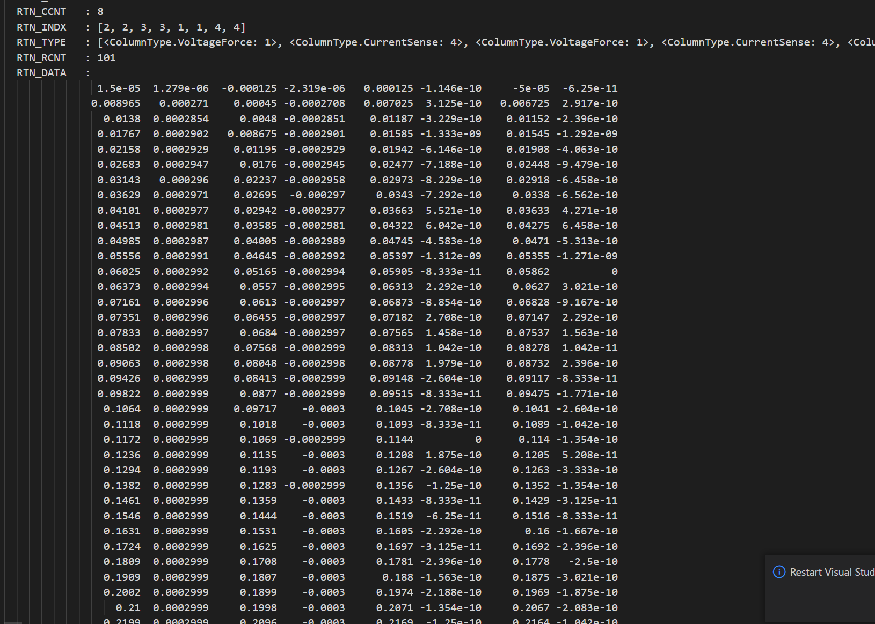
3rd Touchdown （polish tips for 3 times）
short

Slide 5
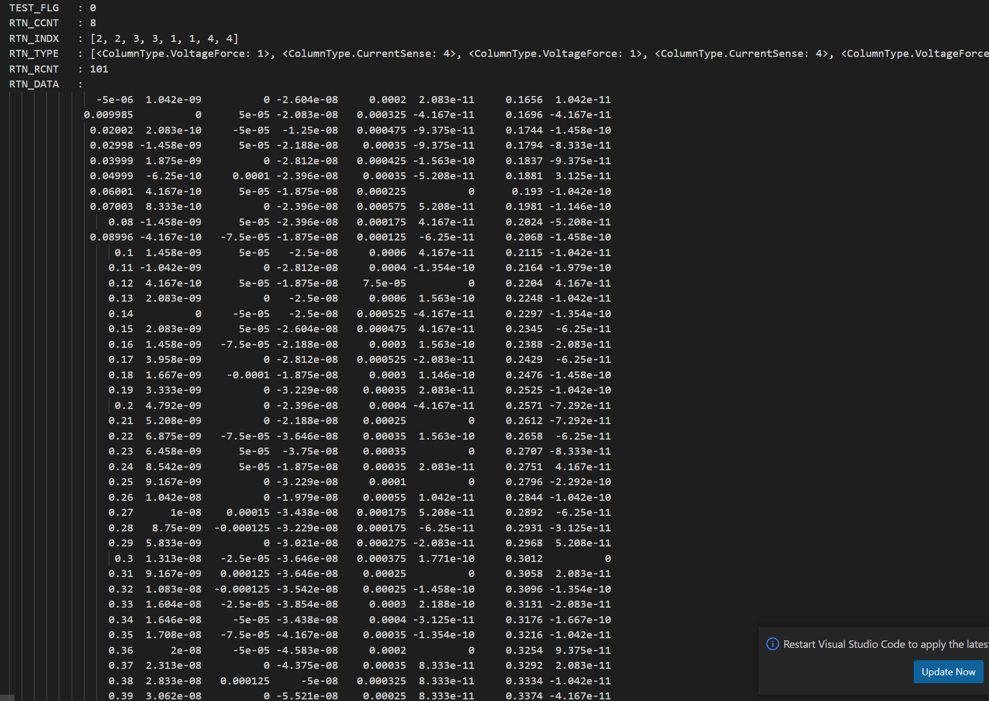
4th Touchdown
Open

Slide 6
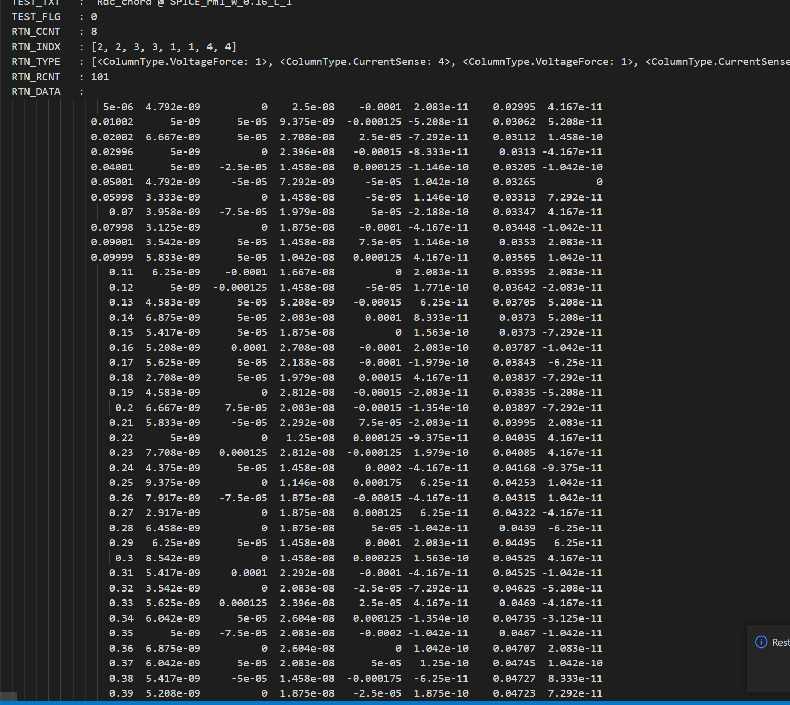
5th Touchdown
Open

Slide 7
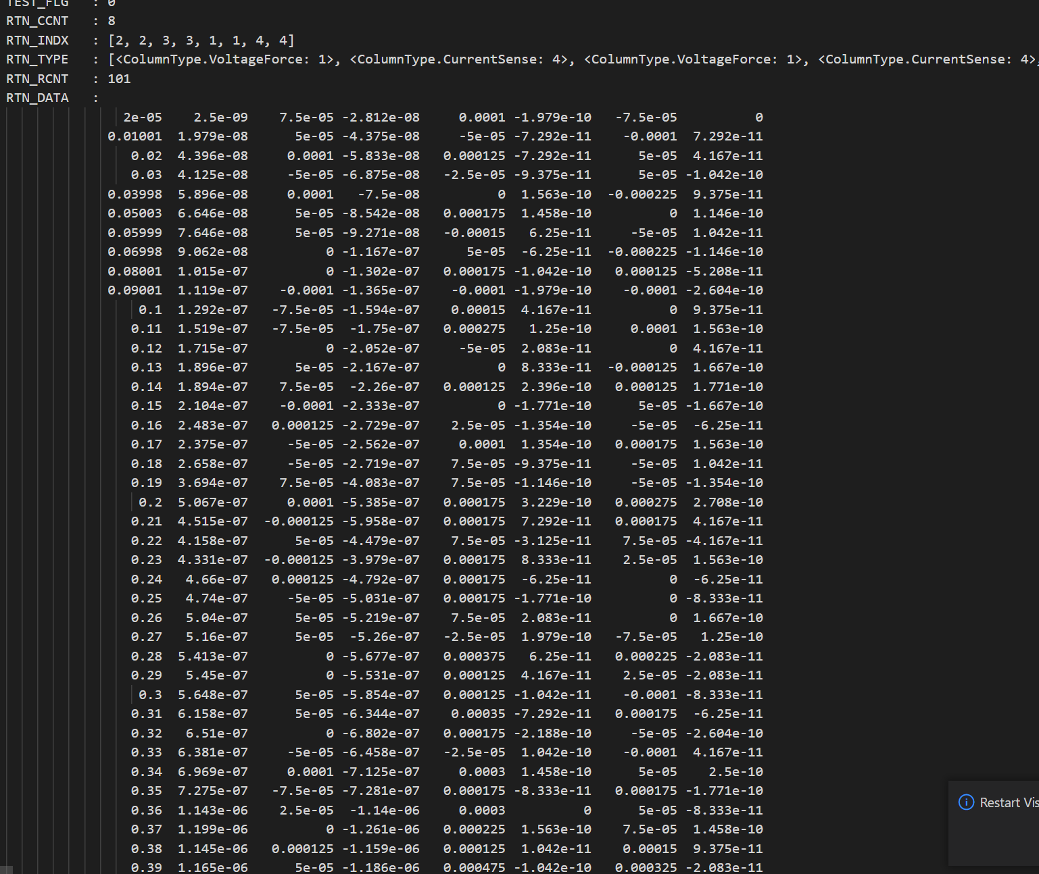
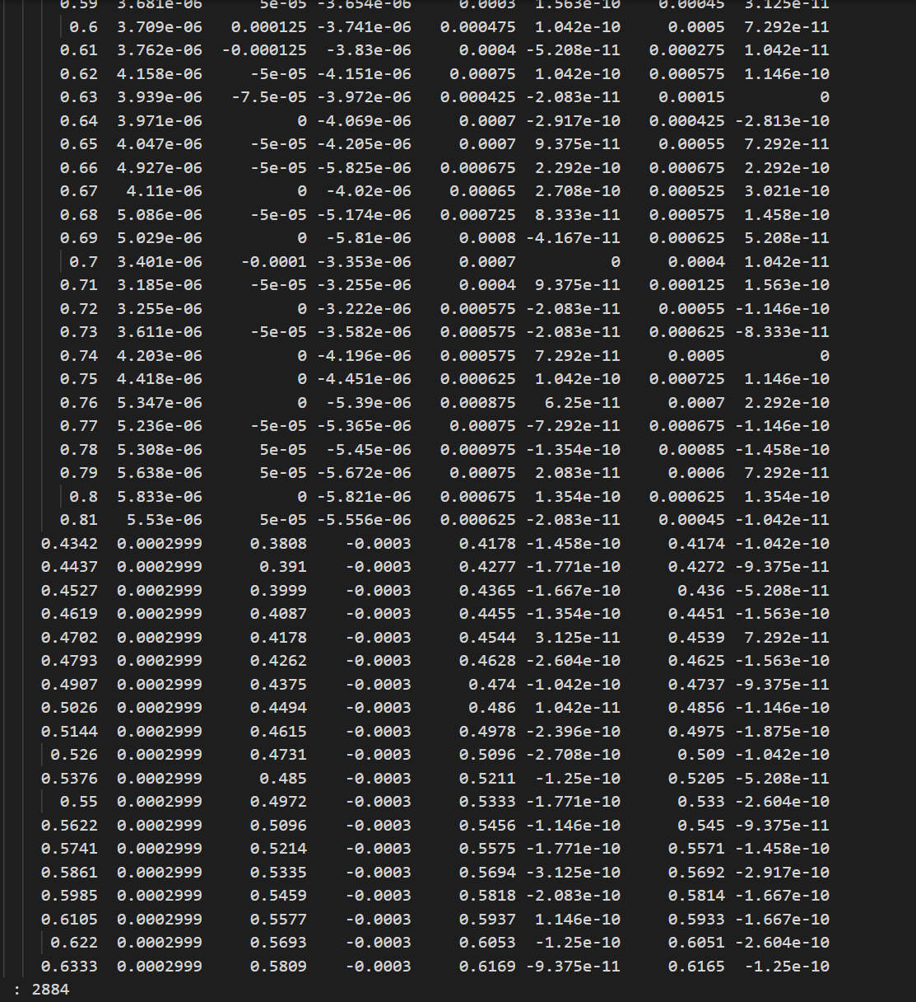
6th Touchdown （after another 3 times polishing）
Short but seems there were debris sticking on tips

Slide 8
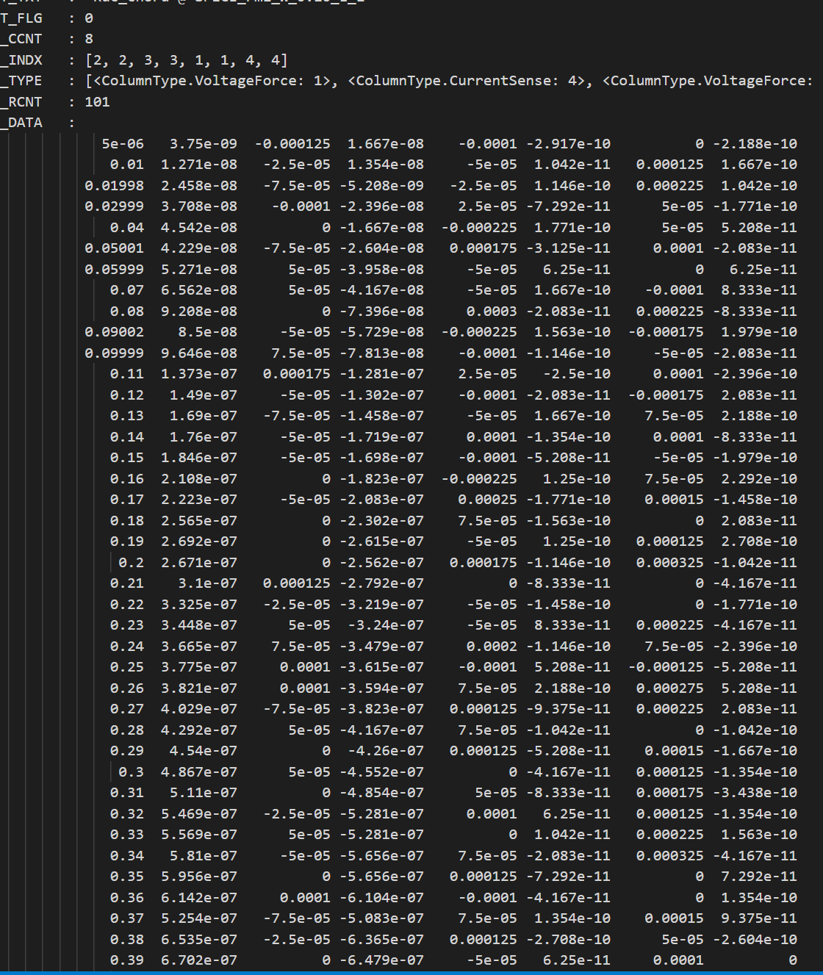
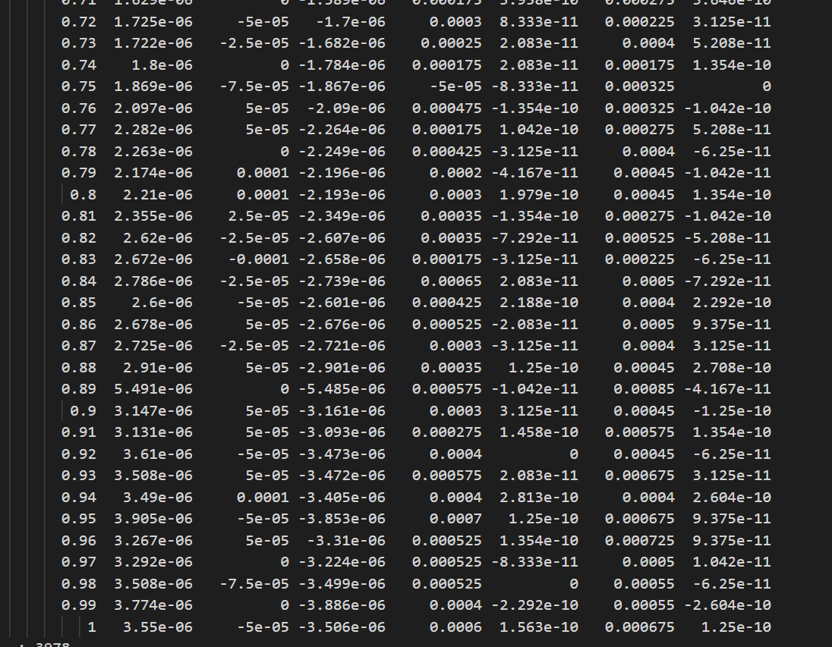
7th Touchdown
Open

Slide 9
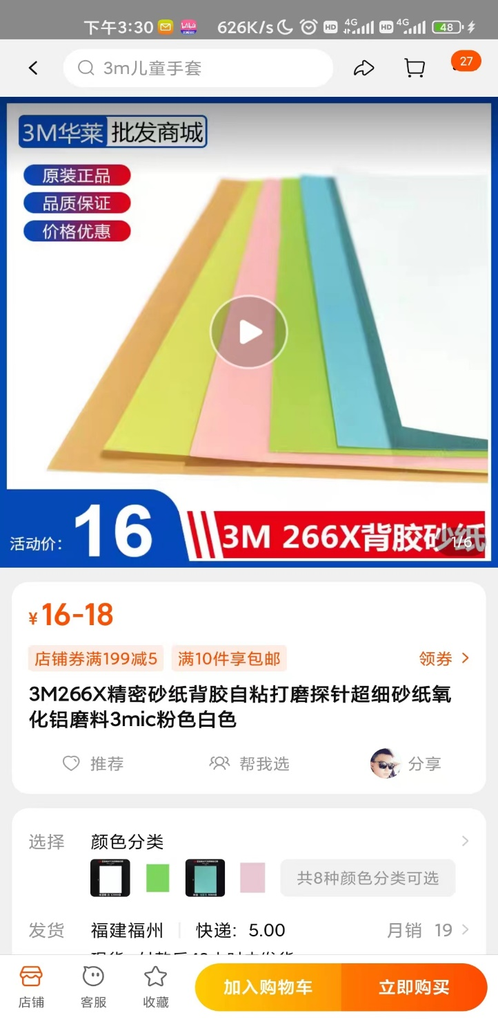

What’s next?
Try→
Expensive, eliminated

